Slide 1

CC 141 Discrete Structures Department of Computer Science School of Systems and Technology University of Management and Technology Lahore, Pakistan

Slide 2

Overview of Previous Lectures
Chapter 1 : The Foundations: Logic and Proofs
1.1 Propositional Logic
Statement, Proposition, Truth value
Propositional symbol, Open proposition
Compound Propositions
Operators
Conditional statements
Truth tables of compound propositions
Precedence of logical operators
Logic and bit operation
1.2 Application of Propositional Logic
Translating English Statement
System Specifications
Boolean Searches
Logic Puzzles
Logic Circuits

Slide 3
Section 1.3: PROPOSITIONAL EQUIVALENCES
Tautology, Contradiction & Contingency
Logical Equivalence

Slide 4
TAUTOLOGY
A compound proposition that is always true, no matter what the truth values of the propositional variables that occur in it, is called a tautology.
Examples:
P ∨ (¬ P)
¬ (P ∧ Q) ↔ (¬ P) ∨ (¬ Q)

Slide 5
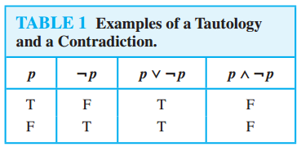
CONTRADICTION
A compound proposition that is always false is called a contradiction.
Examples:
P ∧ (¬ P)
¬(¬(P ∧ Q) ↔ (¬P) ∨ (¬Q))

Slide 6
CONTINGENCY
A compound proposition that is neither a tautology nor a contradiction is called a contingency.
Examples:
P ∧ Q
P ∨ (¬ Q)

Slide 7
Class Activity
Use truth table to show that [(p → q) ∧ p] → q is a tautology.
Use truth table to show that (p ∧ ~q) ∧ (~p ∨ q) is a contradiction.

Slide 8
LOGICAL EQUIVALENCE
Compound propositions that have the same truth values in all possible cases are called logically equivalent.
The compound propositions p and q are called logically equivalent if p ↔ q is a tautology.
The notation p ≡ q denotes that p and q are logically equivalent.

Slide 9
p ≡ q
LOGICAL EQUIVALENCE
The symbol ≡ is not a logical connective
Hence, p ≡ q is not a compound proposition, rather it is the statement that p ↔ q is a tautology.
The symbol ⇔ is sometimes used instead of ≡ to denote logical equivalence.

Slide 10
LOGICAL EQUIVALENCE
Definition: two propositional statements S1 and S2 are said to be (logically) equivalent, denoted S1 ≡ S2 if
They have the same truth table, or
S1 ⇔ S2 is a tautology
Equivalence can be established by
Constructing truth tables
Using equivalence laws

Slide 11
LOGICAL EQUIVALENCE using TRUTH TABLES
Prove that ¬(P∧Q) and (¬P)∨(¬Q) are logically equivalent
and ¬(P∧Q)↔(¬P)∨(¬Q) is a Tautology
P | Q | ¬(P∧Q) | (¬P)∨(¬Q) | ¬(P∧Q)↔(¬P)∨(¬Q)
T | T
T | F
F | T
F | F
F
T
T
T
F
T
T
T
T
T
T
T

Slide 12
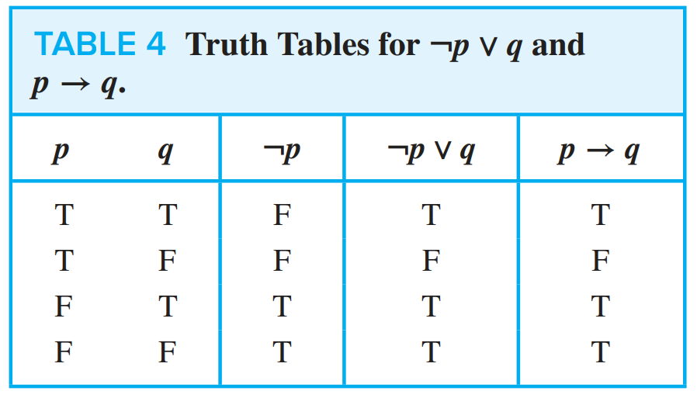
A VERY IMPORTANT EQUIVALENCE
p → q and ￢p ∨ q are logically equivalent

Slide 13
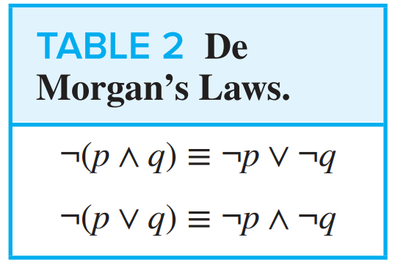
DE MORGAN’S LAWS

Slide 14
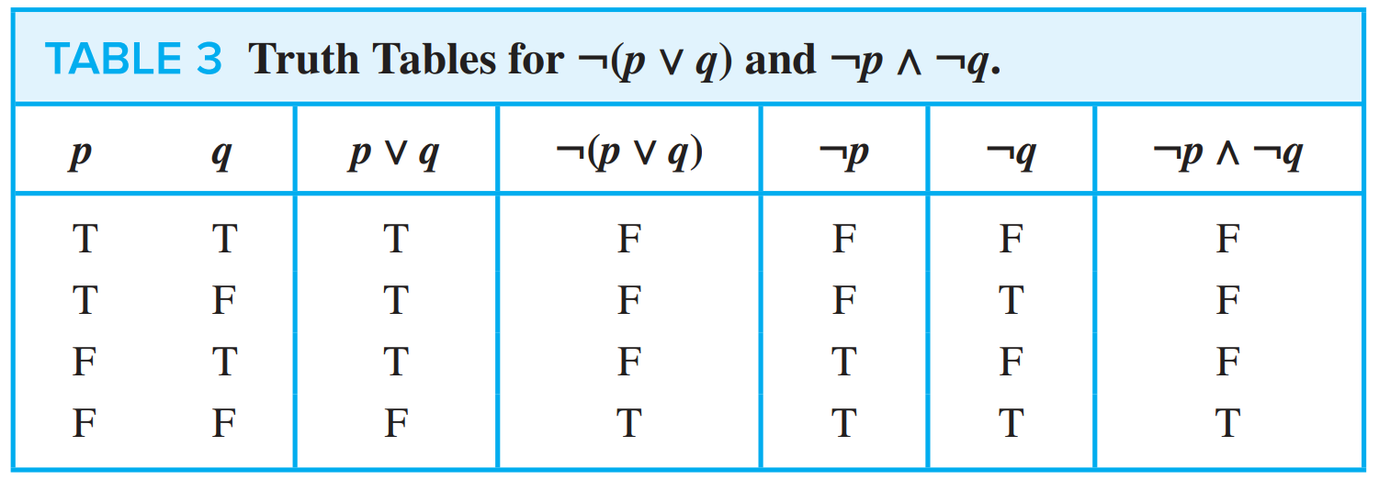
DE MORGAN’S LAWS

Slide 15
DE MORGAN’S LAWS
Express the negations of
“Ahmad has a cellphone and he has a laptop computer”.
“Jack will go to the concert or Steve will go to the concert.”

Slide 16
DE MORGAN’S LAWS
“Ahmad has a cellphone and he has a laptop computer”
“Jack will go to the concert or Steve will go to the concert.”
“Ahmad does not have a cellphone or he does not have a laptop computer.”
“Jack will not go to the concert and Steve will not go to the concert.”

Slide 17
Class Activity
Use De Morgan’s laws to find the negation
Ibrahim is smart and hard working.
Ahmed support Peshawar Zalmi or Karachi Kings

Slide 18
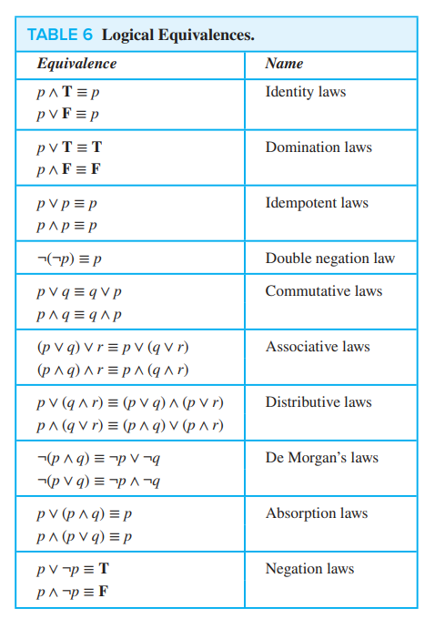
SOME IMPORTANT EQUIVALENCES

Slide 19
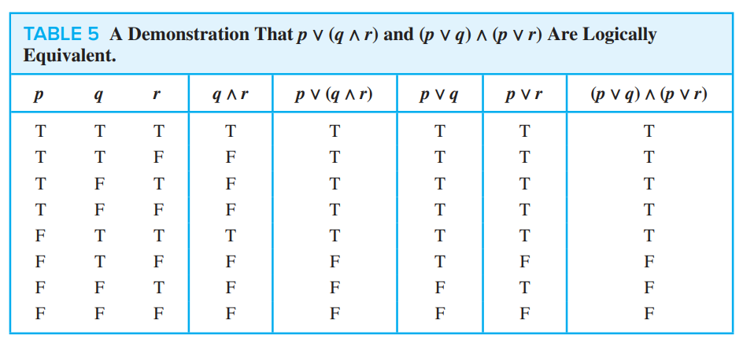
LOGICAL EQUIVALENCES of DISTRIBUTIVE LAW
Show that p ∨ (q ∧ r) and (p ∨ q) ∧ (p ∨ r) are logically equivalent.
This is the distributive law of disjunction (OR) over conjunction (AND)

Slide 20
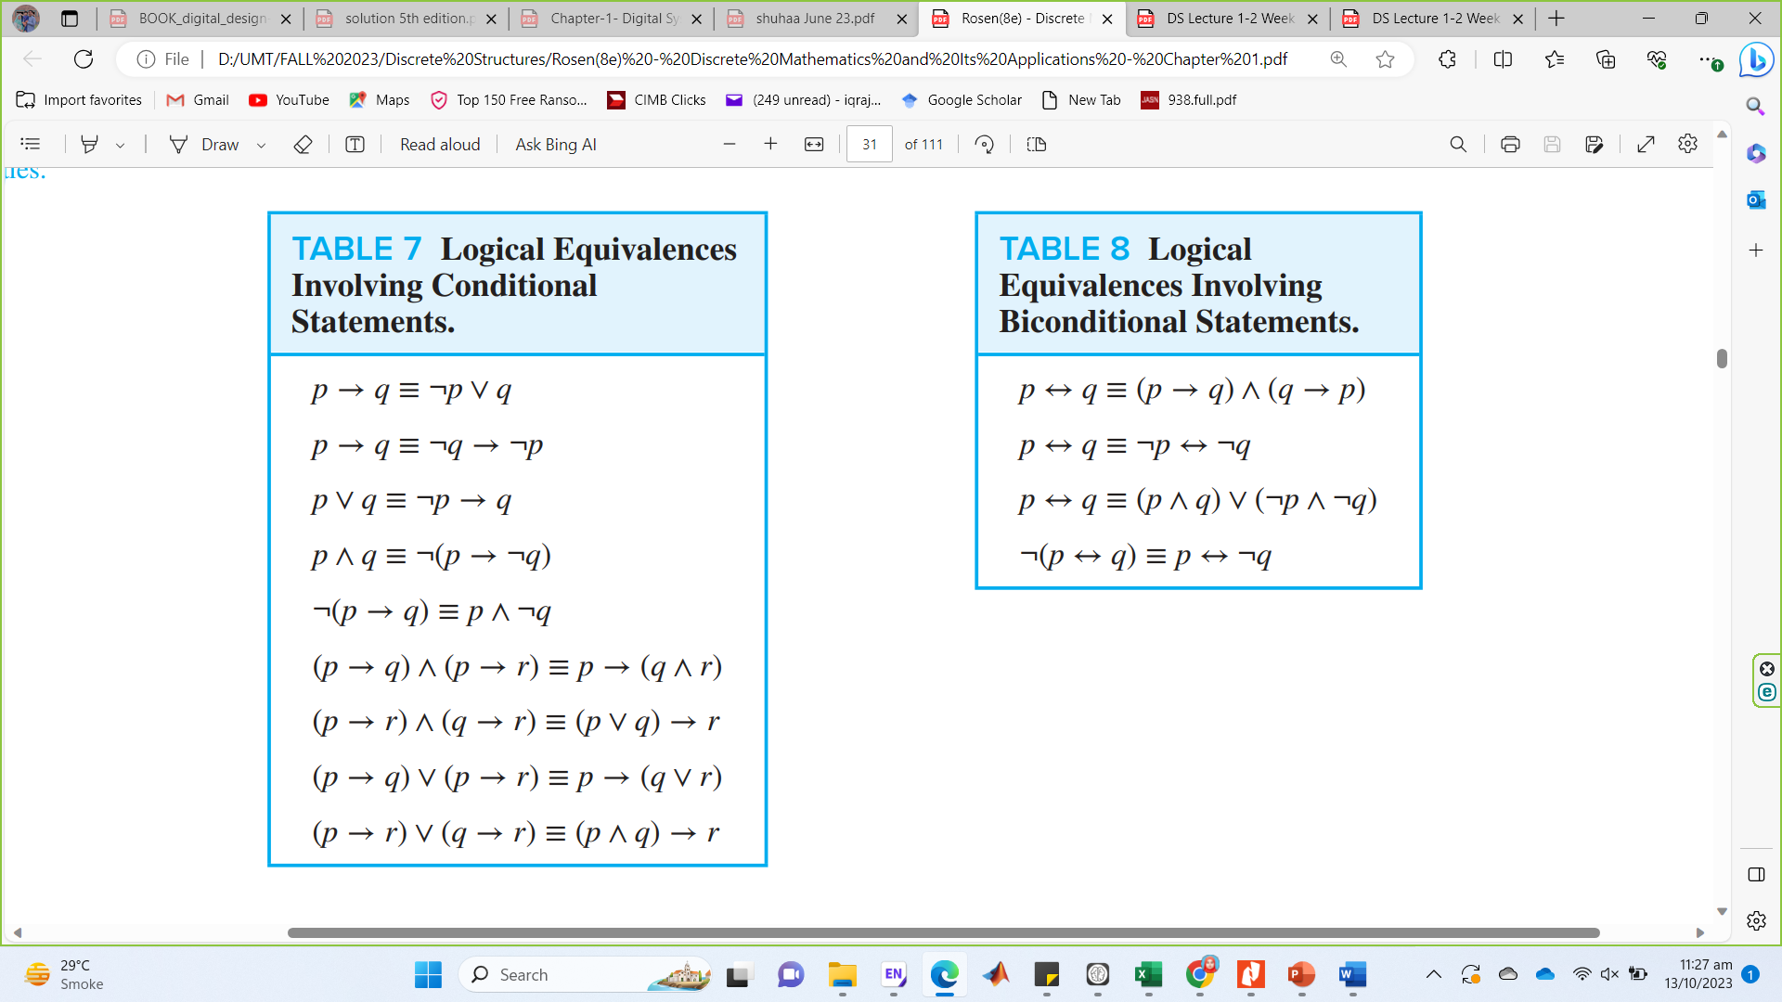
LOGICAL EQUIVALENCES INVOLVING CONDITIONAL STATEMENTS

Slide 21
LOGICAL EQUIVALENCES INVOLVING BICONDITIONAL STATEMENTS

Slide 22
CONSTRUCTING NEW LOGICAL EQUIVALENCES
Using already Established Equivalences

Slide 23
Exercises
Show that (P → Q) ∧ (P → R) ≡ P → (Q ∧ R) by equivalence laws:
LHS = (P → Q) ∧ (P → R)
= (¬ P ∨ Q ) ∧ (¬ P ∨ R ) Implication Law : P → Q = ¬ P ∨ Q
= ¬ P ∨ (Q ∧ R) Distributive Law : P ∨ (Q ∧ R) = (P ∨ Q) ∧ (P ∨ R)
RHS = P → (Q ∧ R)
= ¬ P ∨ ( Q ∧ R ) Implication Law : P → Q = ¬ P ∨ Q
Hence LHS = RHS

Slide 24
Show that ￢(p → q) and p ∧￢q are logically equivalent using Equivalence Laws.
LHS = ￢(p → q)
≡ ￢ (￢p ∨ q) Implication Law : P → Q = ￢ P ∨ Q
≡ ￢(￢p) ∧ ￢q Second DeMorgan law: ￢ (P ∨ Q)= ￢P ∧ ￢ Q
≡ p ∧￢q
= RHS
≡ p ∧￢q Double Negation Law : ￢ (￢ P ) = P
= RHS

Slide 25
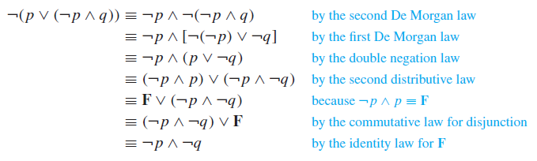
Show that ￢(p ∨ (￢p ∧ q)) and ￢p ∧￢q are logically equivalent.
Second DeMorgan law: ￢ (P ∨ Q)= ￢P ∧ ￢ Q
First DeMorgan law: ￢ (P ∧ Q)= ￢P ∨ ￢ Q
Double Negation Law : ￢ (￢ P ) = P
Distributive Law : P ∧ (Q ∨ R) = (P ∧ Q) ∨ (P ∧ R)
Negation Law : P ∧ ￢ P = F
Commutative Law: P v Q = Q v P
Identity Law : P v F = P

Slide 26
Practice Problems
Q: 1,5,6,7,9,16,17,22,23,24,30

Slide 27
Summary
Chapter 1 : The Foundations: Logic and Proofs
1.3 Propositional Equivalence
Tautology vs Contradiction
Logical Equivalence
DeMorgan’s Law,
Other Laws of Equivalence
Constructing New Logical Equivalences
Using Truth Tables
Using Laws of Equivalences

